Slide 1
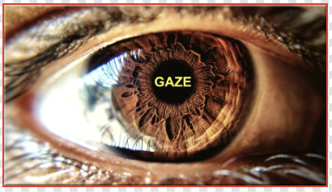
Eye Movement Pattern Based Authentication System [ EPAS ]
Presented by Group-6
[ Review-2 ]

Slide 2
Contents
Overview
Project Description
Project Illustration
Implementation
Applications
Conclusion

Slide 3
Overview
Considering this need a different strategy based on gaze movement was adopted, in which a gaze tracking authentication method would be employed to provide an additional layer of security to the conventional pin or password-based authentication model.
Since privacy is a concern that must be addressed, particularly when it comes to digital data, it is critical to upgrade and improve existing authentication techniques, or to invent new methods.
Notes:
Iris Movement and Gaze Tracking is still a challenging task, as there are many issues associated with such systems. These issues include degree of eye openness, variability in eye size, head pose, etc. Different applications that use eye tracking are affected by these issues at different levels. Several Computer-Vision based eye tracking approaches have been introduced.

Slide 4
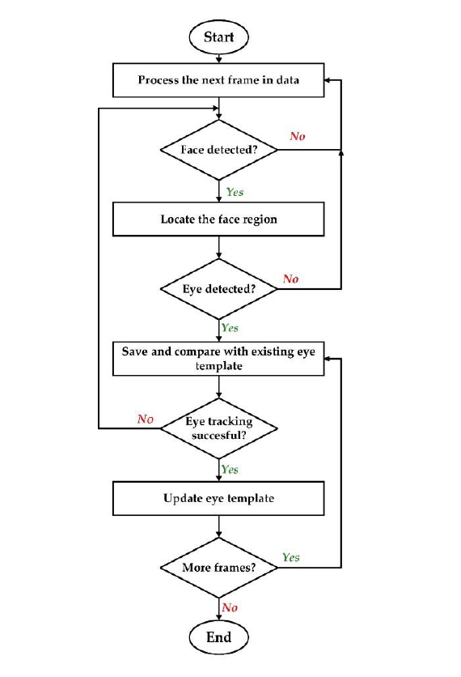
Project Description
Eye Tracking
The geometric and motion characteristics of the eyes are unique which makes gaze estimation and tracking important for many applications such as human attention analysis, human emotional state analysis, interactive user interfaces and human factors. There are many different approaches for implementing Iris movement and Gaze tracking systems. In General most of these approaches execute a recursive process similar to the flowchart alongside

Slide 5
The first step in eye tracking is to detect the eyes. The tracking of eyes in image or video data is based on eye models. An exemplar eye model should be sufficiently meaningful to accommodate the variability in eyes’ dynamics and appearance while adequately constrained to be computationally efficient. Most eye tracking methods presented in literature use Computer Vision based techniques. In these methods, a camera is set to focus on one or both eyes and record the Iris movement
The main focus of this project is on Computer vision based Iris movement and gaze tracking. There are two main areas investigated in the field of Computer vision based eye tracking. The first area is called Iris detection in the image also known as eye localization, The second area is eye tracking, which is the process of eye gaze direction and estimation. Based on the data obtained from processing and analyzing the detected eye region, the direction of the eye gaze can be estimated then it is either used directly in the application or tracked over subsequent video frames in the case of real time eye tracking systems.

Slide 6

Phase- I Experiment

Slide 7
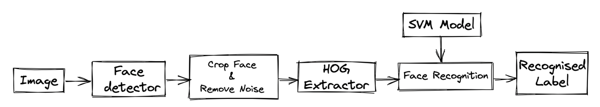
Project Illustration
When we use DLib algorithms to detect features of a human face like nose, mouth, eyes, etc., we get the map of the points surrounding each of these features.
This map is composed of 68 points (called landmark points) and can identify Jaw points, Right & Left Brow Points, Nose points, Right & Left Eye points, Mouth point and Lips points.
For this project, we need to work with the left and right eye points from the above mentioned map.
Tracking Mechanism
Subject’s face containing eyes and portion of surrounding regions is captured with a high-resolution, high-frame-rate camera or WebCam. From the Captured Face, we used OpenCV and DLib for the Face Recognition.
OpenCV is a library of programming functions mainly aimed at real-time computer vision.
DLib is an advanced machine learning library that was created to solve complex real-world problems.
Notes:
Chirag

Slide 8
Horizontal ratio indicates the Horizontal direction of the Gaze
Horizontal_ratio = (pupil_left + pupil_right) / 2
pupil_left = eye_left.pupil.x / (eye_left.center[0] * 2 - 10)
pupil_right = eye_right.pupil.x / (eye_right.center[0] * 2 - 10)
Vertical ratio indicates the Vertical direction of the Gaze
Vertical_ratio = (pupil_left + pupil_right) / 2
pupil_left = eye_left.pupil.y / (eye_left.center[1] * 2 - 10)
pupil_right = eye_right.pupil.y / (eye_right.center[1] * 2 - 10)
LOOKING LEFT: The function A() returns True if the subject is looking left (horizontal_ratio() >= 0.65).
LOOKING RIGHT: The function B() returns True if the subject is looking left (horizontal_ratio() >= 0.65).
LOOKING CENTER: When both of the above functions return false then the function gaze.is_centre() returns True.
Notes:
Chirag

Slide 9
Phase- II Experiment
Notes:
Chirag

Slide 10
Implementation
The model basically detects and provides the authentication pin based on the Eye movement and we patch it through an API to our web backend to authenticate the login application. The wrong eye movement works in a similar manner as a wrong pin entered would work and declines the request.
For the Web application we're gonna be using a React application for the client end and Express to make api calls and a NoSQL Mongo database to store correct pin information.
We're gonna use an Open CV based ML software to track and measure the Delta or the direction in which the person is looking at. We've a model pre trained to detect right/left/up/down motion.
Notes:
Iris Movement and Gaze Tracking is still a challenging task, as there are many issues associated with such systems. These issues include degree of eye openness, variability in eye size, head pose, etc. Different applications that use eye tracking are affected by these issues at different levels. Several Computer-Vision based eye tracking approaches have been introduced.

Slide 11
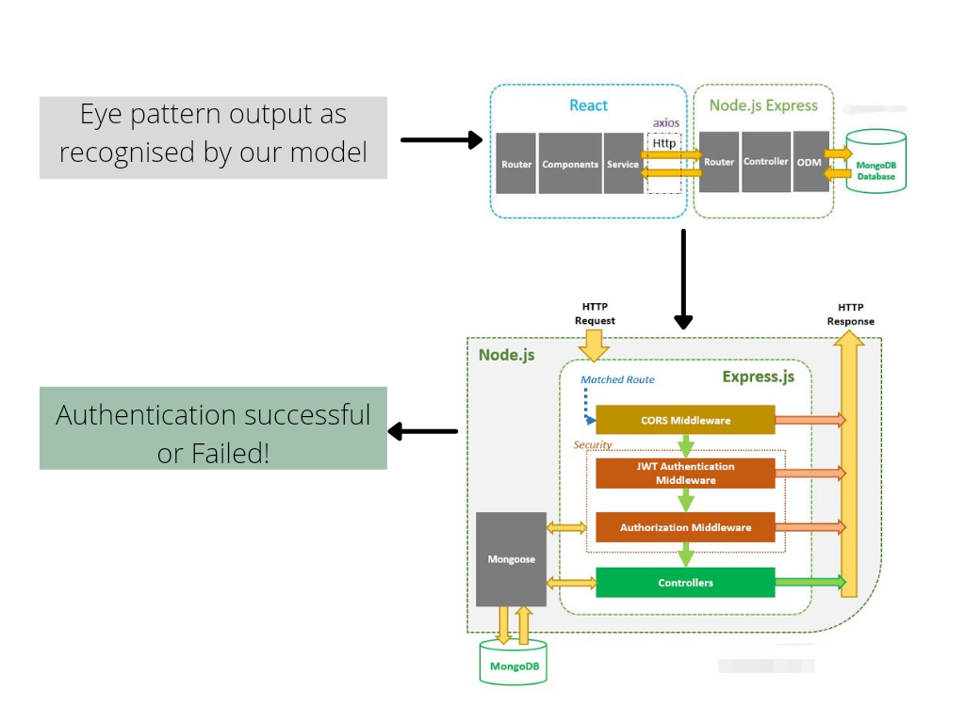

Slide 12
Potential Use Cases/Application
Banking Applications
ATM’s
Employee checkpoints
EV’s authentication
Smart Appliances
Any IOT based devices needing authentication

Slide 13

Conclusion
Information security is a significant factor when it comes to digital gadgets. We are continually concerned about the misuse of our personal information. That is why, in order to verify that a person is who he claims to be, the Iris Movement and Gaze tracking approach was adopted here, as it is also considered an effective and dependable human-computer interface.
Notes:
Iris Movement and Gaze Tracking is still a challenging task, as there are many issues associated with such systems. These issues include degree of eye openness, variability in eye size, head pose, etc. Different applications that use eye tracking are affected by these issues at different levels. Several Computer-Vision based eye tracking approaches have been introduced.

Slide 14

Presented By :
Chirag Ganguli
19BCY10158
Blesson Biju Abraham
19BCY10079
Subham Biswal
19BCY10136
Tushar Gupta
19BCY10019

